Slide 1

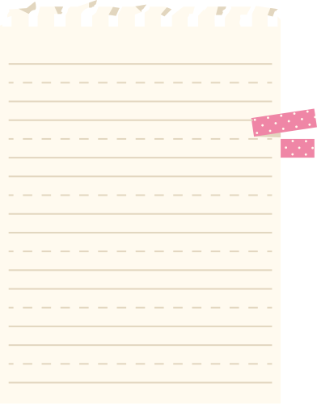




Introduction to MLA Format
ULM Reference

Slide 2

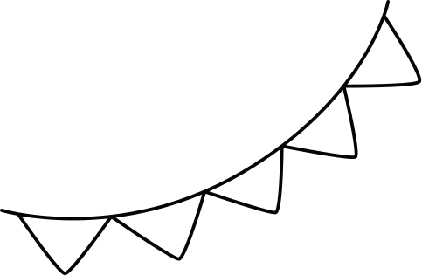






Session Overview
1
What is MLA Format/How to Use it?
2
GuidelinesQuotes/Paraphrasing
3
In-Text Citations/Works Cited
4
Questions

Slide 3





What is MLA Format?
Defined
Who Uses it?
MLA Format is a system of documenting sources that was authored by the Modern Language Association.
This format is used for documenting sources in disciplines such as English and the Humanities.

Slide 4
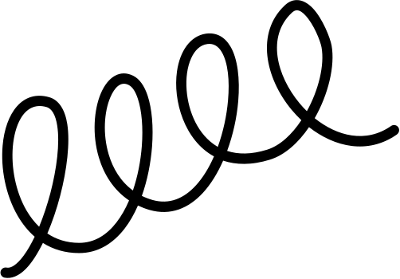


Why Do We Use MLA?
MLA Format Users
Give Authors Credit
Standardized Formatting
Academic writers write for their peers and write in academic journals, books, novels, etc.
MLA allows you as a writer to give credit to authors for using their work or ideas in your research paper.
Use MLA to format sources in research papers in a standardized way.

Slide 5

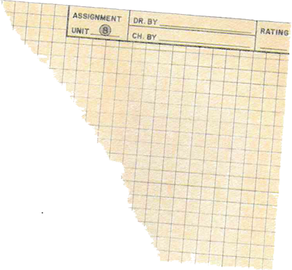

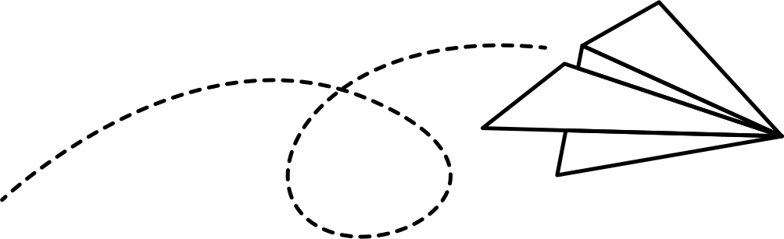
So You Will Use It To....
Format Your Paper
Guide the Style of Your Paper
  Margins
  Spacing
  Font selection and size
  Headers/Footers
  Quotations
  In-text citations
  Voice

Slide 6



General Guidelines
  1 inch margin on all pages.
  Double space each line.
  Use 12 point font for the font size.
  Use a professional font type such as Times New Roman.

Slide 7



General Guidelines
Page Headers
Spacing
Using Indents
Refining Prose
  Include page numbers and author’s name.
  May be omitted from first page.
Only one space following ending punctuation of sentences.
Indent first sentence of paragraphs ½ inch from margin – MLA recommends simply using the Tab key (versus spacing over manually).
Use active voice whenever possible.

Slide 8
General Guidelines
Cover Pages
Headings
MLA papers don’t typically need cover pages – so unless your professor asks for one, it’s not necessary to create one
MLA papers do need a heading in which you list your name, your professor’s name, the class, and the date – this is typically double-spaced

Slide 9
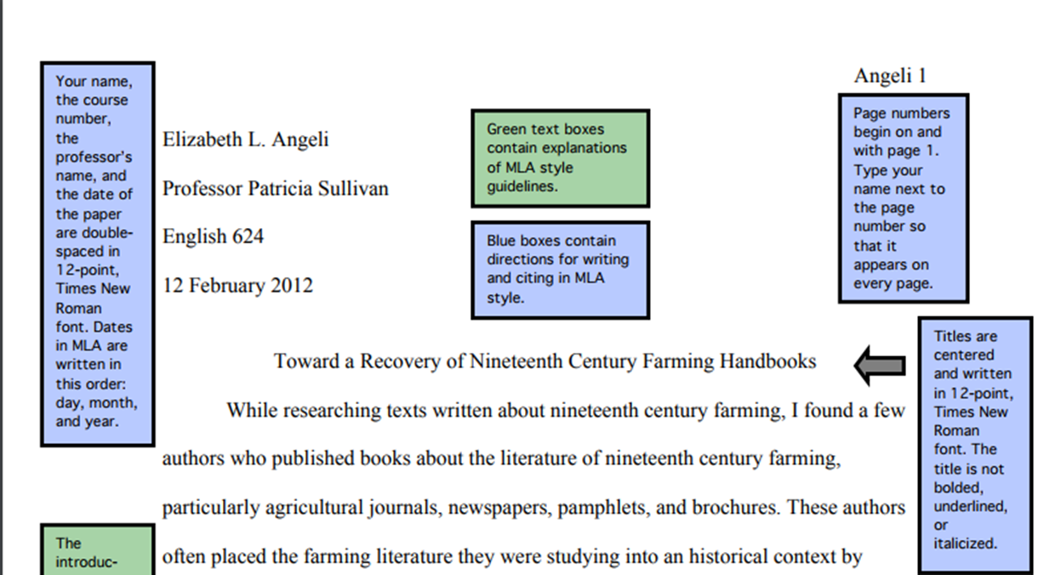
Guidelines First Page
  Format your papers

Slide 10
Guidelines First Page
Examples of titles within titles:
  The Function of Time in Woolf’s To the Lighthouse.
  Sexuality in Faulkner’s “A Rose for Emily”.
  Race and Race Relations in Baraka’s “Dutchman”.

Slide 11


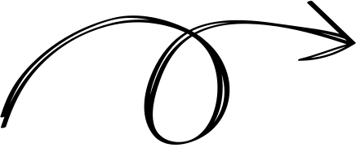

Quotations/
Paraphrasing
When you are writing a research paper, you are going to have to work other people’s research into your own, in order to:
  Demonstrate your point of view
  Inform the audience of what research has been done on the topic
  Show your audience how your point of view fits into what’s been done.

Slide 12

Quotations/Paraphrasing
  There are two ways of incorporating information into your paper – quoting and paraphrasing
  MLA has guidelines for how to use quotations and paraphrasing in your writing
  It’s important to understand how these two methods differ

Slide 13
Quotations
  Quotations are the actual words taken from the text, word for word, as they appear in the text itself.
  Quotations can be high impact – the words of an expert that support your argument carry a lot of weight.

Slide 14




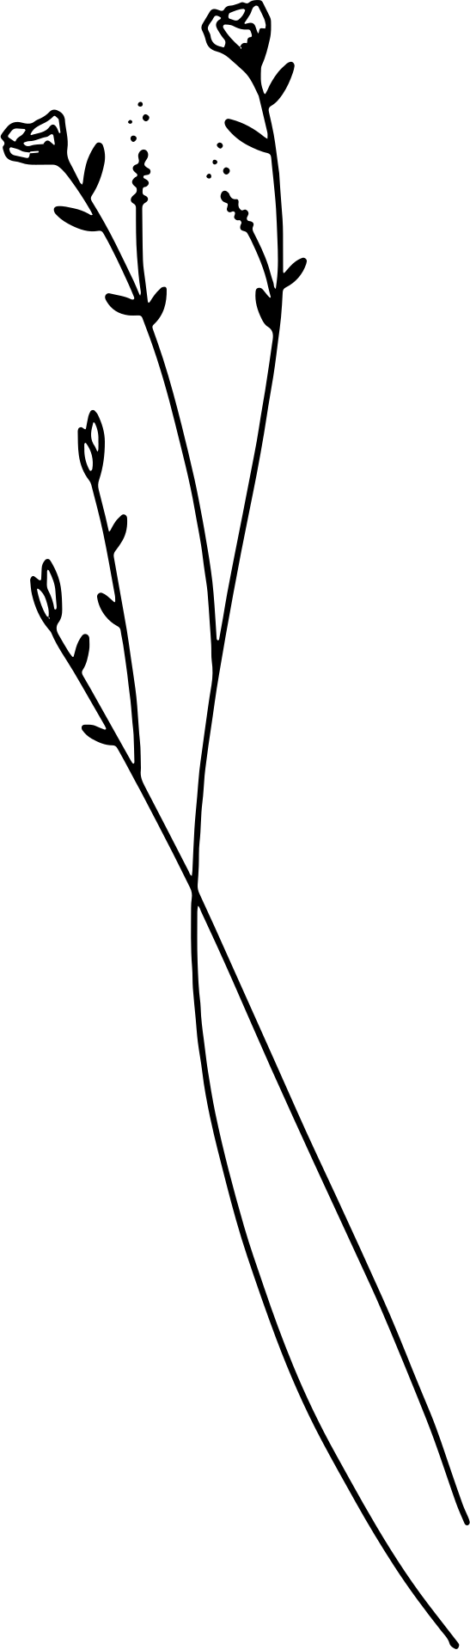


Quotations and Quoting
  Including too many quotations is lazy; don’t let the research do all the work!
  Too many quotes can look like plagiarism- don’t use someone else’s ideas as your argument rather than as support.
  *You* are supposed to do the work; quotes are just tools with which to do the work.

Slide 15
Quotations and Quoting
There are two ways to quote:
  1st way- In direct quotations, use the author’s name as part of the sentence.
Examples:
  Dickens said, “it was the best of times, it was the worst of times.”
  According to Dickens, “it was the best of times, it was the worst of times.”

Slide 16


Quotations and Quoting
  Direct quotations do not allow for change- a direct quotation is, word for word, identical to the way it appears in the original text.
  The original text MUST HAVE QUOTATION MARKS around it.
Examples:
  Dickens said, “it was the best of times, it was the worst of times” (62).
  According to Dickens, “it was the best of times, it was the worst of times” (62).
The quotation marks show where the author’s words begin and end, distinguishing them from YOUR writing.

Slide 17





Quotes and Quotations
  2nd way: indirect quotation - DO NOT include the author
or author’s names in the sentence.
  But you still have to use quotation marks, and you can’t make changes to the text.
Not the author’s name
Some researchers note that “children are totally
insensitive to their parents’ shyness” (Zimbardo 62).
Author’s name is here

Slide 18

Paraphrasing
  A second way you can incorporate information into your writing is to paraphrase.
  Paraphrasing is the act of taking information from a text and either
    Summarizing it – taking a whole paragraph’s worth of information and boiling it down to a few sentences, or
    Rewording it - demonstrating your understanding of the information by putting it into your own words, in such a way that is significantly different from the original text.

Slide 19

Paraphrasing Summary
ORIGINAL TEXT-- TOO LONG TO QUOTE
Children are totally insensitive to their parents' shyness; it is the rare child who labels a parent shy [...] This is understandable, since parents are in positions of control and authority in their homes and may not reveal their shy side to their children. Also, since shyness is viewed as undesirable by many children, it may be threatening to think of parents in these terms. At this young age, the parent is still idealized as all-knowing and all-powerful - - not dumb, ugly, or weak.
Zimbardo, Philip G. Shyness: What It Is, What to Do About It. Perseus Books, 1977.

Slide 20



Paraphrasing Summary
SUMMARY OF ORIGINAL TEXT – EASIER TO USE
Because parents are authority figures in the home, children are not immediately aware of their parents’ shyness; it may be too scary for the children to think of their parents in negative terms.

Slide 21
Paraphrasing: Rewording
In Your Own Words
Avoid Plagiarism
If you aren’t concerned with the length of a section, or you feel you can’t boil the information down without losing something important, you have the option of putting the information in your own words.
Make sure the info really is in your own words – if it’s too close to the original text, it could be considered plagiarism.

Slide 22
Plagiarism: Rewording
Paraphrasing Result
In Your Own Words
Give Authors Credit!
The result of paraphrasing a paragraph may produce a paragraph of equal length, and that’s okay
What’s important is that the information is actually in your own words.
Give authors credit for their ideas in the text of your papers and in the Works Cited section of your paper.

Slide 23

Paraphrasing: Rewording
ORIGINAL TEXT-- TOO LONG TO QUOTE
Children are totally insensitive to their parents' shyness; it is the rare child who labels a parent shy [...] This is understandable, since parents are in positions of control and authority in their homes and may not reveal their shy side to their children. Also, since shyness is viewed as undesirable by many children, it may be threatening to think of parents in these terms. At this young age, the parent is still idealized as all-knowing and all-powerful - - not dumb, ugly, or weak.
Zimbardo, Philip G. Shyness: What It Is, What to Do About It. Perseus Books, 1977.

Slide 24


Paraphrasing: Rewording
REWORDED/PARAPHRASE
A parent’s shyness is not often perceived by a child, and rarely would a child describe a parent as being shy. Because parents are authority figures in the home, that shyness may not manifest, nor may the parent behave bashfully in front of the child. Moreover, shyness is often valued in a negative fashion by children, so to think of a parent in this fashion can be unsettling to the child. The child idolizes the parent at this stage of development.
Zimbardo, Philip G. Shyness: What It Is, What to Do About It. Perseus Books, 1977.

Slide 25


Quoting versus Paraphrasing: When?
  Both of these methods of using resources in your writing have many benefits – so how do you decide when to use which?
  Remember: quoting is usually high impact – it’s good for emphasis, when you think taking the words out of the horse’s mouth is the best means of persuasion.
  Quoting is like a punch: your opponent CANNOT ignore it!

Slide 26

Quoting versus Paraphrasing: When?
  Paraphrasing is better for condensing a lot of information into a more manageable amount (like we saw in the summary example).
  It’s also very useful when the information is very technical or the author’s style is very dry and inaccessible – you can make the info more easy to consume for your audience.
  You can also combine authors’ ideas that are similar into one passage through paraphrasing.

Slide 27
Paraphasing: More on Combining Ideas
Let’s say you have two authors who say similar things on a topic.
Zimbardo writes:
Smith writes:
Children are totally insensitive to their parents' shyness.
Children are usually unaware when their parents are shy.

Slide 28
Paraphrasing: More on Combining Ideas
These two passages of information can be blended together (mmmm….info smoothie) to keep your information concise and to prevent unnecessary repetition. So, a paraphrase of their information blended together would look like this:
Some researchers note that children are often
ignorant with regard to their parents’ shyness
(Zimbardo 62; Smith 45).

Slide 29

Incorporating Info Into Your Own Writing
  It’s NOT recommended that you just put quotations in your writing without some kind of preamble or introduction or explanation
  A good rule of thumb is that every sentence in your writing should contain something you wrote, no matter what
  Transitions are important, particularly between your writing and thoughts, and the quotations

Slide 30

Incorporating Quotations Into Your Writing
And it’s not necessary for every quotation to end the sentence – let’s look at the variants on the Zimbardo quotations again.
Zimbardo notes that “children are totally insensitive to their parents’ shyness” (62), though some authors disagree.
Some researchers note that "children are totally insensitive to their parents' shyness" (Zimbardo 62), but other authors disagree.

Slide 31

In-text Citations
Give Authors Credit
Use In-text Citations
When using someone else’s work in your own – whether you’re quoting or paraphrasing – you’ll need to give credit where credit is due, or document what isn’t your work.
This is where in-text citations come in – you’ve seen a few already, but we’ll look at them more closely now.

Slide 32
In-text Citations
  These are used to cite resources within the text.
  Every in-text citation should have a corresponding citation in the Works Cited section.
  If you quote something directly from a text, then the citation will include the author or authors’ names and page number.

Slide 33

In-text Citations
Direct quotation, author named in a sentence.
According to Jones, "Students often had difficulty using APA style, especially when it was their first time" (199).

Slide 34



In-text Citations, Continued
Direct quotation, author not named in sentence.
According to some researchers, "Students often had
difficulty using APA style, especially when it was their first time" (Jones 199).
Please note: the period doesn’t come until AFTER the in-text citation. The sentence isn’t complete until the citation is complete.

Slide 35
In-text Citations, Continued
  Long quotations (more than four lines) should be set apart (that is, not within the text, but in a block quotation)
  Omit quotation marks
  Indent 1 inch (2 hits to the Tab key) from margin
  Maintain double spacing
  Same rules apply for in-text citation, EXCEPT that the quotation will end with its punctuation, then followed by the citation

Slide 36
In-text Citations, Continued
Long direct quotation
One study found the following:
Students often had difficulty using APA style, especially when it was their
first time citing sources. This difficulty could be attributed to the fact that
many students failed to purchase a style manual or to ask their teacher for
help. (Jones 199)

Slide 37
In-text Citations, Continued
  Even if you’re paraphrasing something, you’ll still need to identify the original source
  In-text citations work for paraphrasing, too
  The in-text citations will include the author’s name and page numbers, if available; remember, if the author is unknown, use an abbreviated version of the title

Slide 38

In-text Citations, Continued
Paraphrasing in-text citations
According to Jones, APA style is a difficult citation format for first-time learners (199).
APA style is a difficult citation format for first-time learners (Jones 199).
MLA uses an author-page format in in-text citations (“MLA In-Text Citations”).

Slide 39
Works Cited
  The Works Cited page lists the resources you used in your paper – this is where you document those sources
  Remember: if you have an in-text citation, you will have a corresponding bibliographic citation in your references
  References are double-spaced, too

Slide 40
Works Cited, Continued
  On the Works Cited page: center the title “Works Cited” (without quotation marks) at the top of the page
  All lines following the first line of the citation will be indented a one half-inch from the margin (also known as a hanging indent)
  Italicize titles of long works, like books or journal titles
  Put quotation marks around the titles of short works, like essays or articles

Slide 41
Works Cited, Continued
Author names are inverted; that is, last name first, first name last
In resources with more than one author, all other authors’ names are first name first, last name last
If a source does not have an author, the citation will be alphabetized based on title

Slide 42

Works Cited, Continued
The core elements of any works cited entry are given below in the order in which they should appear; Not all entries will have all of these
  Author.
  Title of source.
  Title of container,
  Other contributors,
  Version,
  Number,
  Publisher,
  Publication date,
  Location.

Slide 43
Works Cited, How to Cite Authors
  The author’s name is usually displayed in a work near the title
  Begin the entry with the author’s last name, followed by a comma and the rest of the author’s name
  End this element with a period
Examples:
Jacobs, Alan. The Pleasures of Reading in an Age of
Distraction. Oxford UP, 2011.
Doris, Michael, and Louise Erdich. The Crown of
Columbus. HarperCollins Publishers, 1999.
Burdick, Anne, et. al. Digital Humanities. MIT Press, 2012.

Slide 44

Works Cited, How to CiteTitles of Sources
  After the author, the next element included in a works cited entry is the title of the source
  The title is often displayed in a work near the author
  Italicize larger works like books and collections of essays or poems
Example:
Puig, Manuel. Kiss of the Spider Woman. Translated by
Thomas Colchie, Vintage Books, 1991.
  Put quotation marks around shorter works such as titles of article names, essays, stories, or poems
Example:
Goldman, Anne. “Questions of Transport: Reading Primo Levi
Reading Dante.” The Georgia Review, vol. 64, no. 1, 2010,
pp. 69-88.

Slide 45


Works Cited, How to Cite
Titles of Container
  When the source being documented forms a part of a larger whole, (like a book that is a collection of essays) the larger whole can be thought of as a container
  The title of the container is usually italicized and followed by a comma, since the information that comes next describes the container
Examples:
Journal is made up of articles
Williams, Joy. “Rogue Territory.” The New York Times Book Review, 9
Nov. 2014, pp.1+.
Television series is made up of episodes
“Hush.” Buffy the Vampire Slayer, created by Joss Whedon,
performance by Sarah Michelle Gellar, season 4, episode 10,
Mutant Enemy, 1999.

Slide 46


Works Cited, How to Cite
Other Contributors
  Aside from an author whose name appears at the start of an entry, other people may be credited in the source as contributors, and you note this if their participation is important to your research or to the identification of the work
  Common descriptors are: adapted by, directed by, edited by, illustrated by, introduction by, narrated by, performance by, and translated by
Example:
“Hush.” Buffy the Vampire Slayer, created by Joss Whedon,
performance by Sarah Michelle Gellar, season 4, episode 10,
Mutant Enemy, 1999.

Slide 47

Works Cited, How to Cite Versions
  If a source carries a notation indicating it is a version of an edition of a work released in more than one form, you may want to identify the version in your entry
Examples:
The Bible. Authorized King James Version, Oxford UP,
1998.
Newcomb, Horace, editor. Television: The Critical View.
7th ed., Oxford UP, 2007.
Scott Ridley, director. Blade Runner. 1982. Performance
by Harrison Ford, Director’s Cut, Warner Bros., 1992.

Slide 48

Works Cited, How to Cite Number
  If the source you are citing is part of a numbered sequence, you may want to document that
Examples:
Multiple Volume Set
Rampersand, Arnold. The Life of Langston Hughes. 2nd ed.,
vol. 2, Oxford UP, 2002.
Journal Issues (includes volume and issue numbers)
Baron, Naomi S. “Redefining Reading: The Impact of Digital
Communication Media.” PMLA, vol. 128, no. 1, Jan. 2013,
pp. 193-200.

Slide 49

Works Cited,
How to Cite Publisher
  The publisher is the organization responsible for producing the source or making it available to the public
  If more than one publisher is listed and they seem equally responsible, list each and separate the names with a slash (/)
Example:
Jacobs, Alan. The Pleasures of Reading in an Age of
Distraction. Oxford UP, 2011.
  Another Tip: For websites published by organizations, including museums, libraries, and universities, the publisher can be found in the “about us” or copyright information

Slide 50

Works Cited, How to Cite Publisher, Continued
A publishers name may be omitted for:
    Periodicals/Journals
b.Works published by authors or editors
c. A website whose title is essentially the same as
the name of its publisher
d. A website not involved in producing the works
or makes it available such as Youtube

Slide 51
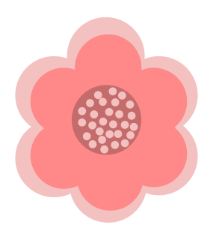

Works Cited, How to Cite: Publication Date
  Sources– especially those published online– may be associated with more than one publication date or may just have one date to document
  When a source carries more than one date, use the date most relevant to your use of the source
Examples:
For an Article on the Website of a News Organization
Deresiewicz, William. “The Death of the Artist—and the Birth of the Creative
Entrepreneur.” The Atlantic, 28 Dec. 2014,
www.theatlantic.com/archive/2015/01/the-death-of-the-artist-and-the-
birth-of-the-creative-entrepreneur/383497/.
Book
Rampersand, Arnold. The Life of Langston Hughes. 2nd ed., vol. 2, Oxford UP,
2002.

Slide 52
Works Cited,
How to Cite: Location
  How to specify the work’s location depends on the medium of publication
Examples:
Print sources (uses a range of page numbers)
Goldman, Anne. “Questions of Transport: Reading Primo Levi Reading Dante.” The
Georgia Review, vol. 64, no 1, 2010, pp. 69-88.
Websites (uses URL)
Deresiewicz, William. “The Death of the Artist—and the Birth of the Creative
Entrepreneur.” The Atlantic, 28 Dec. 2014,
www.theatlantic.com/archive/2015/01/the-death-of-the-artist-and-the- birth-of-
the-creative-entrepreneur/383497/.
Physical Objects
Bearden, Romare. The Train. 1975, Museum of Modern Art, New York.

Slide 53

MLA Resources
  The Online Writing Lab (OWL) at Purdue: MLA
https://owl.purdue.edu/owl/research_and_citation/mla_style/mla_formatting_and_style_guide/index.html
  Son of Citation Machine: Citation Generator
http://citationmachine.net/
  EasyBib: Free Automatic Bibliography & Citation Maker
http://www.easybib.com/

Slide 54
Questions?

Slide 55
Contact Us
Remember, if you need research help, all you have to do is ask the librarians
You can…
  Email us at reference@ulm.edu
  Call us at (318) 342-1071

