Slide 1
ULM
What to Consider When Time and Effort Planning
Office of Sponsored Programs and Research

Slide 2
Time and Effort Planning Overview
Helpful Terms Related to Time and Effort
What to Consider When Effort Planning
About Personnel Cost Sharing at ULM

Slide 3
Helpful Terms Related to
Time and Effort
Sponsored Projects involve a specific commitment of time and can be either: 1) externally funded activities in which a formal written agreement, such as a cooperative agreement, contract, or grant is entered into by ULM and by a sponsor for research, training, or other public service activities; or 2) internally funded for which the activities are separately budgeted and accounted for by ULM as a result of a formal application and approval process.
Institutional Responsibilities those activities for which an individual is paid by ULM. Responsibilities can include administrative duties, instruction, research, and service.
Effort is the amount of time spent on any activity expressed as a percentage of total institutional responsibilities for which an individual is compensated by ULM or sponsored program. Projected or committed effort and the employee’s actual effort must be commensurate with his/her responsibilities.
Institutional Base Salary is the total guaranteed annual compensation an individual receives from ULM whether the time is spent on research, service, or other activities.

Slide 4
Helpful Terms Related to
Time and Effort continued…
Salary Recovery from Sponsored Program; also referred to as Buy-Out is faculty/staff salary payment to the university through extramural funding (from awards made to the university by a sponsored program - agencies and third parties - for research, instruction, or public service projects) in order to partially release the employee from university responsibilities (research, teaching, service, or administrative duties) so that the employee member can spend this portion of their time and effort on the awarded research/project.
Appointment Period is listed on Appointment Letter at the time of hiring ULM faculty and staff on an annual basis. The university operates on a modified semester system with two semesters during the academic year, three summer terms, and winter session. ULM employees are employed for selected semesters, Fall/Spring for 9-month faculty or by 10-month, 12-month and other time periods.

Slide 5
What to Consider When Effort Planning:
ULM requires that an individual’s total institutional responsibilities not exceed 100% within their appointment period (9-months, 10-months, academic year, etc.) and are consistent with his/her other duties (instruction, service, research and possibly administration).
  It is important to understand that effort is not calculated on a 40-hour workweek or any other standard workweek, but as a percent of a portion of set ULM responsibilities.
  It is most common for tenure and tenure-track 9-month faculty to have a workload percent of 60% instruction, 30% research and 10% services. It is common for tenure and tenure-track 12-month College of Pharmacy faculty to have a workload percent of 45% instruction, 45% research, and 10% service. And it is common for department heads/chairs or deans to have a lesser percent of instruction and a designated percent of effort for administration. Therefore, tenure and tenure-track faculty tend to complete their sponsored program work as part of their research time. Those that need additional time to work on their sponsored project tend to have paid course-buy outs or conduct their sponsored project work outside of their appointed period.
ULM allows employees to take on additional responsibilities outside of their appointed period (Maymester, Summer I, Summer II, Wintersession, after work hours, etc.). All responsibilities, whether they are teaching overloads or sponsored programs, outside of the appointed period cannot exceed 30% above the employee’s institutional base salary.
  Also refer to student and Graduate Assistant policies on workload.

Slide 6
What to Consider When Effort Planning: continued…
ULM policy on minimum effort allows ULM employees to claim 1% committed effort for the sponsored program s/he is involved in. Exceptions to the minimum level of effort are for equipment and instrumentation grants, doctoral dissertation grants, and augmentation grants. The minimum effort and the employee’s actual effort must be commensurate with his/her responsibilities.
Department Heads/Chairs and Deans are limited to a maximum of 50% effort on sponsored projects during their appointment period. Faculty members, Deans, and Department Heads/Chairs may commit more effort when approved on a case-by-case basis by Academic Affairs.
In the case of a training grant or other project which specifically restricts any salary charges, effort is recorded as voluntary uncommitted cost-sharing unless specifically required as a mandatory committed cost-sharing activity by the sponsor.

Slide 7
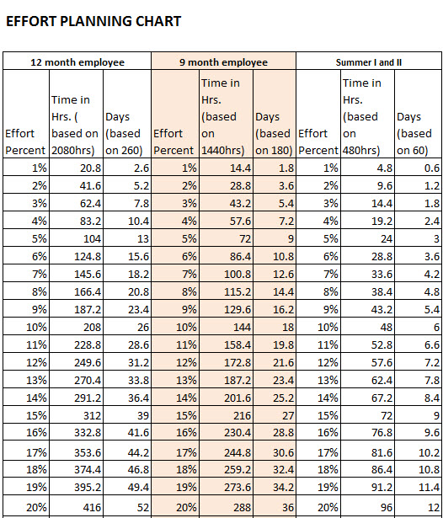
What to Consider When Effort Planning: continued…
Refer to the calculation formulas located in the instruction page of the ULM OSPR Official Budget Form.
Use the Effort Planning Chart to determine commitment level in hours/days/effort

Slide 8
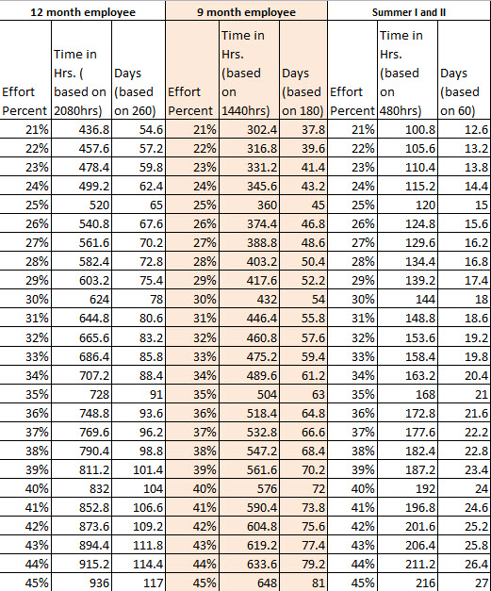
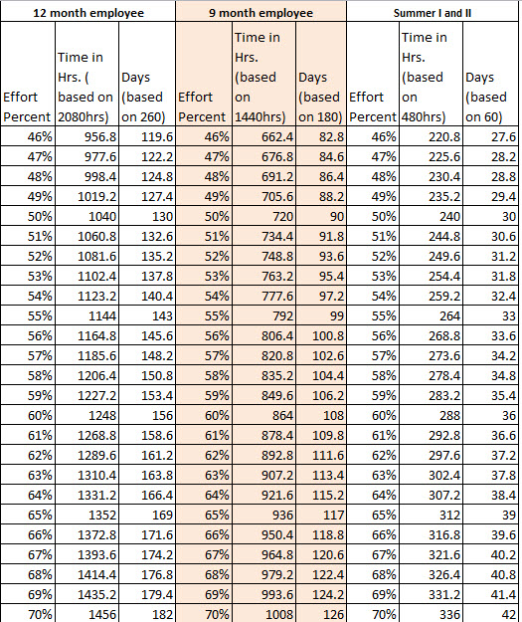
What to Consider When Effort Planning: continued…
Chart continued…

Slide 9
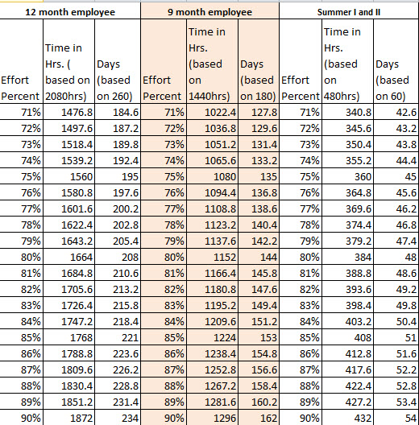
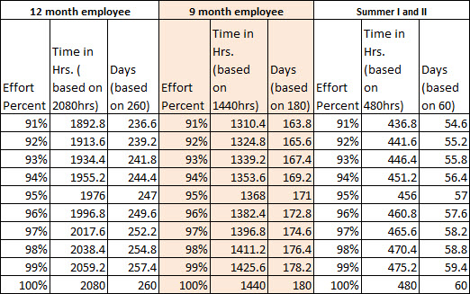
What to Consider When Effort Planning: continued…
Chart continued…

Slide 10
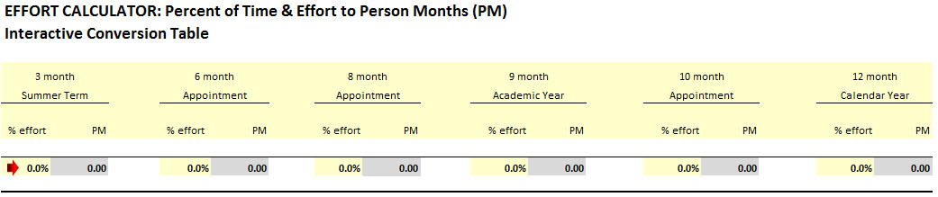
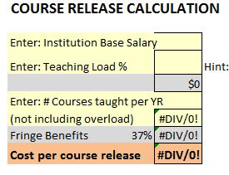
What to Consider When Effort Planning: continued…
To calculate effort from a percent to months:
To calculate course release cost for a faculty member

Slide 11
About Match/Cost Sharing at ULM:
The ULM Policy on Cost Sharing requires that only the minimum amount required by the sponsor is allowed. Voluntary Cost Sharing is discouraged unless the proposed Cost Sharing meets the University’s needs. Cost Sharing may be required by the sponsor or volunteered; however, any commitment of effort, whether solicited or volunteered, that is referenced in the awarded proposal must be honored, reported, and captured in the ULM Time and Effort Reporting system.
Pre-Award Stage
During the Pre-Award stage, mandatory and voluntary cost sharing commitments are reviewed and approved by the Deans of the colleges as well as by personnel in the OSR. When monetary cost sharing commitments are involved, each Department Chair, Dean, and respective Budget Authority must review, approve, and sign the actual account from which the monetary commitment is to be charged as part of the ULM Proposal Routing and Approving Forms located at: http://www.ulm.edu/research/forms.html.

Slide 12
About Match/Cost Sharing at ULM: continued…
Post-Award Stage
When a notice of grant award is received (Post-Award stage) in which cost sharing was proposed, the cost sharing becomes a binding commitment that must be provided for and tracked in a consistent manner by the Principal Investigator.
All cost shared commitments are to be monitored and reported by the PI to the Grants and Contract Division of the ULM Controller’s Office for financial reporting. In addition, the OSPR Office must receive Time and Effort Certification reports for each ULM faculty/staff/student/employee who is cost shared to the sponsor or paid by the sponsor.
The Principal Investigator is responsible for notifying his/her supervisor of newly-awarded sponsored project that requires cost sharing commitments on behalf of the individual, the department, and/or the college. The PI is also responsible for notifying the OSPR Office of any changes in personnel or new hires for the project.

Slide 13
Questions?
Please contact us
Office of Sponsored Programs and Research
(318) 342-1039
ospr@ulm.edu
www.ulm.edu/research

